Slide 1
2026 Quilt Show Recap and 2027 Quilt Show Announcement
May 25, 2026

Slide 2
Ballot Survey Results
335 out of 439 (76%) voters completed the short survey.
Question #1: How did you hear about the show (check all that apply)?
“Other” included Lanakila Senior Center, Instagram, Quilting Class, Poakalani, Downtown Arts Center, and Kaimuki Dry Goods.

Slide 3
Survey Results
Question #2: Is this your first time attending?
321 responses
Question #3: Show size.
291 responses.

Slide 4
Financials
Revised from newsletter | 2026 | 2025
QT Sales | $7,607 | $8,470
HQG 15% Commissions Received | $392 | $287
Program Advertisements | $1,165 | $1,165
Donations | $1,148 | $622
TOTAL REVENUE | $10,231 | $10,544
Expenses are projected to exceed revenue by approximately $2,500. Major expenses included:
Pipe and drape – $5,400 ($1,000 less than 2025)
Printing program – $2,166 (increase of $200 from 2025)
Reception – $1,000 ($1,000 less than 2025)
Interior signs – $697
Looking ahead to next year:
Increase ad pricing to cover more of the costs to print the program
Expenses for interior signs will be lower
We can absorb this year’s shortfall. However, Quilted Treasures’ sales remain very important in the future – MAHALO to everyone who contributed to the shop (or bought!)

Slide 5
Quilted Treasures Big Sellers
Anything with palaka
Pineapple ornaments
Potholders with insulbrite, placemats, bowl cozies, bowl covers, aprons
Baby quilts
Zippered pouches of all sizes and types, and other items handy for travel
Carla Simao’s cards
Pam Bechtel’s pen holder bookmarks
Mary Carvalho’s needle books (perfect for Poakalani quilters) and project bags
A list of free patterns is available on the quilt show website. Labels are available at each meeting.

Slide 6
2027 Quilt Show – BLOCK PARTY
April 29 – May 9

Slide 7
2027 Featured Artist – Guess who?!
Focus will be on QUILTING.
  We had lots of questions from visitors about the difference between free motion and computerized quilting.
  It’s time to educate them with the works of our Featured Artist!
She is a Modern quilter.
She doesn’t use a long-arm, but quilts free motion on a sit-down machine.

Slide 8
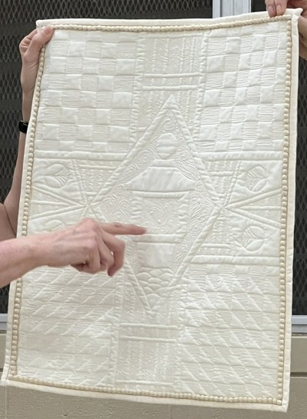
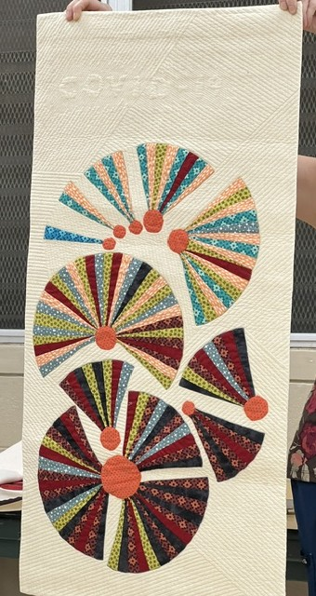
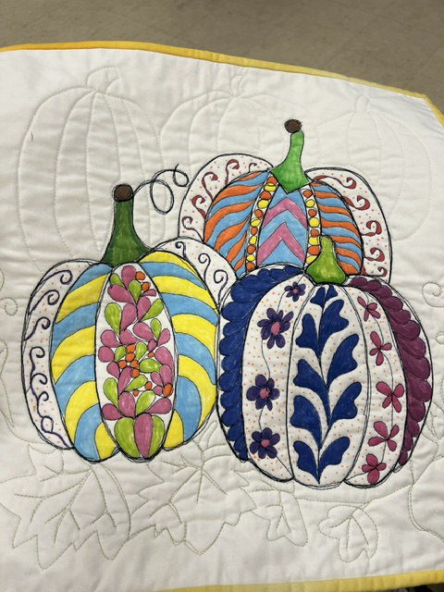
Congratulations, Ruth Davis!

Slide 9
2027 challenge

Slide 10
1 x 4 Challenge
This Challenge explores the creative potential of a narrow vertical format.
The rules are simple:
Your project must be started after the May 2026 meeting and completed by the March 22, 2027 meeting.
Dimensions: The finished quilt must measure 12” wide by 48” long (1x4) – no shorter, no longer. We will use a 1” tolerance to confirm eligibility.
The quilt must hang vertically.
The quilt must include either hanging corners or a sleeve for display purposes, and a label.
It must be a true quilt sandwich consisting of a top, middle, and back held together by quilting stitches or ties.
Your creativity is limited only by the parameters of these rules.

Slide 11
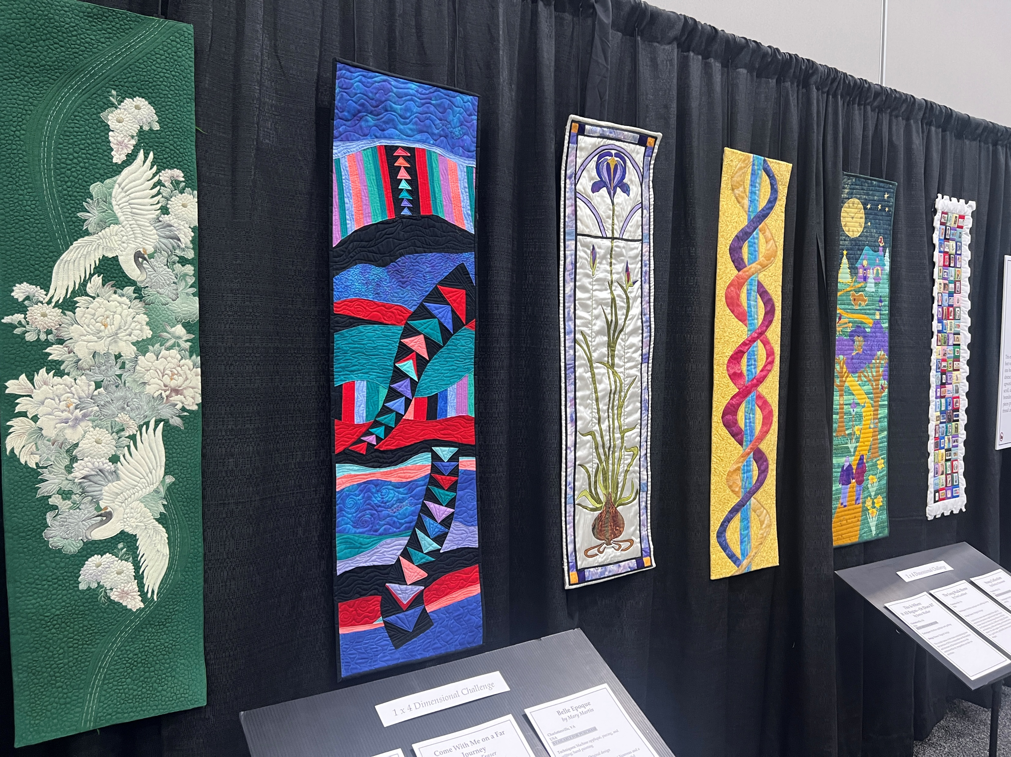
Examples from 2025 International Quilt Festival
Quilters drew inspiration from nature, abstraction, and personal stories.
Each quilt stretches upward like a towering landscape or an unfolding scroll.
Examples are ART quilts. We are NOT limiting submissions to Art quilts. Pieced blocks are encouraged!

Slide 12
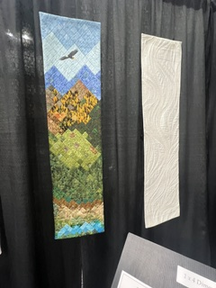
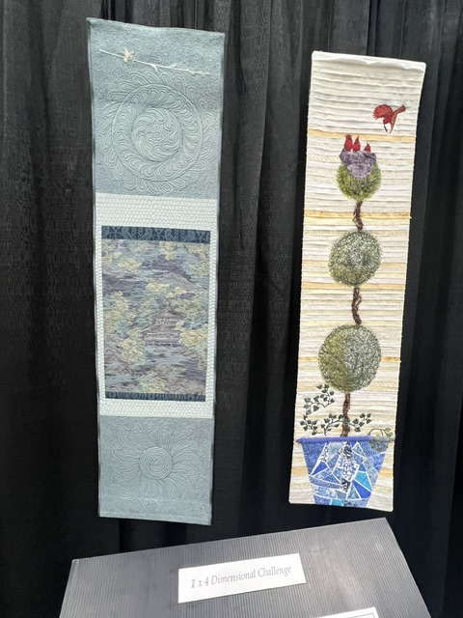
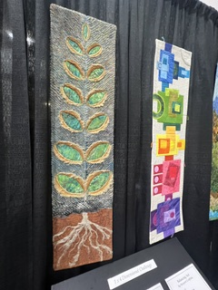
More Examples

Slide 13
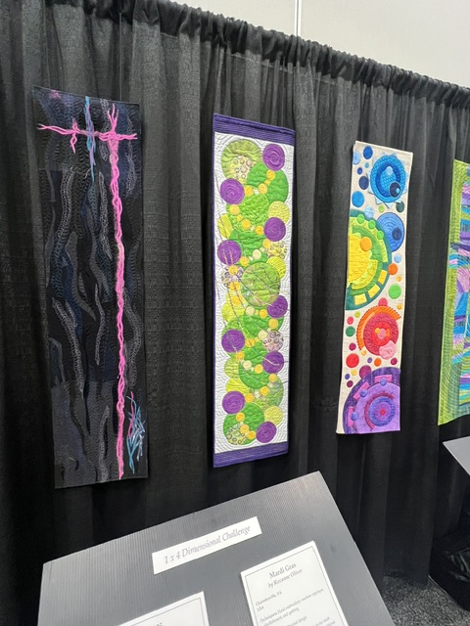
More Examples
Pieced block quilters DON’T BE DISCOURAGED! Make blocks and fit them into the
12” x 48” vertical format.

Slide 14
Any questions?

